Slide 1
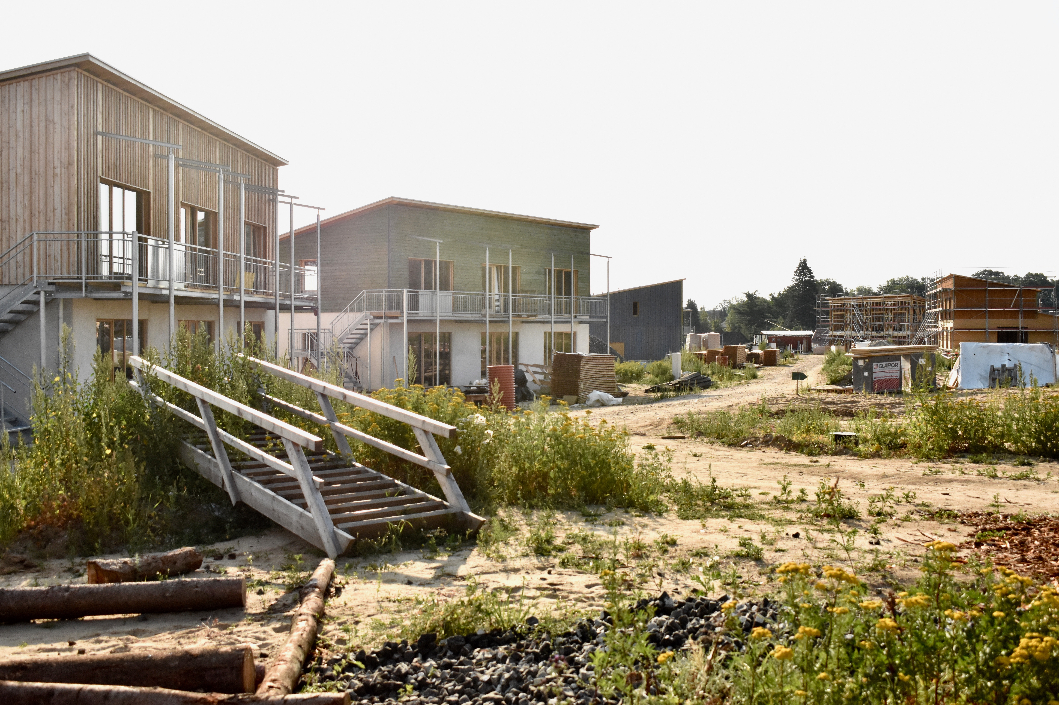
OF OTHER PLACES
Place-Making Between Contradiction and Conformity
Rebekka Diestelkamp

Slide 2
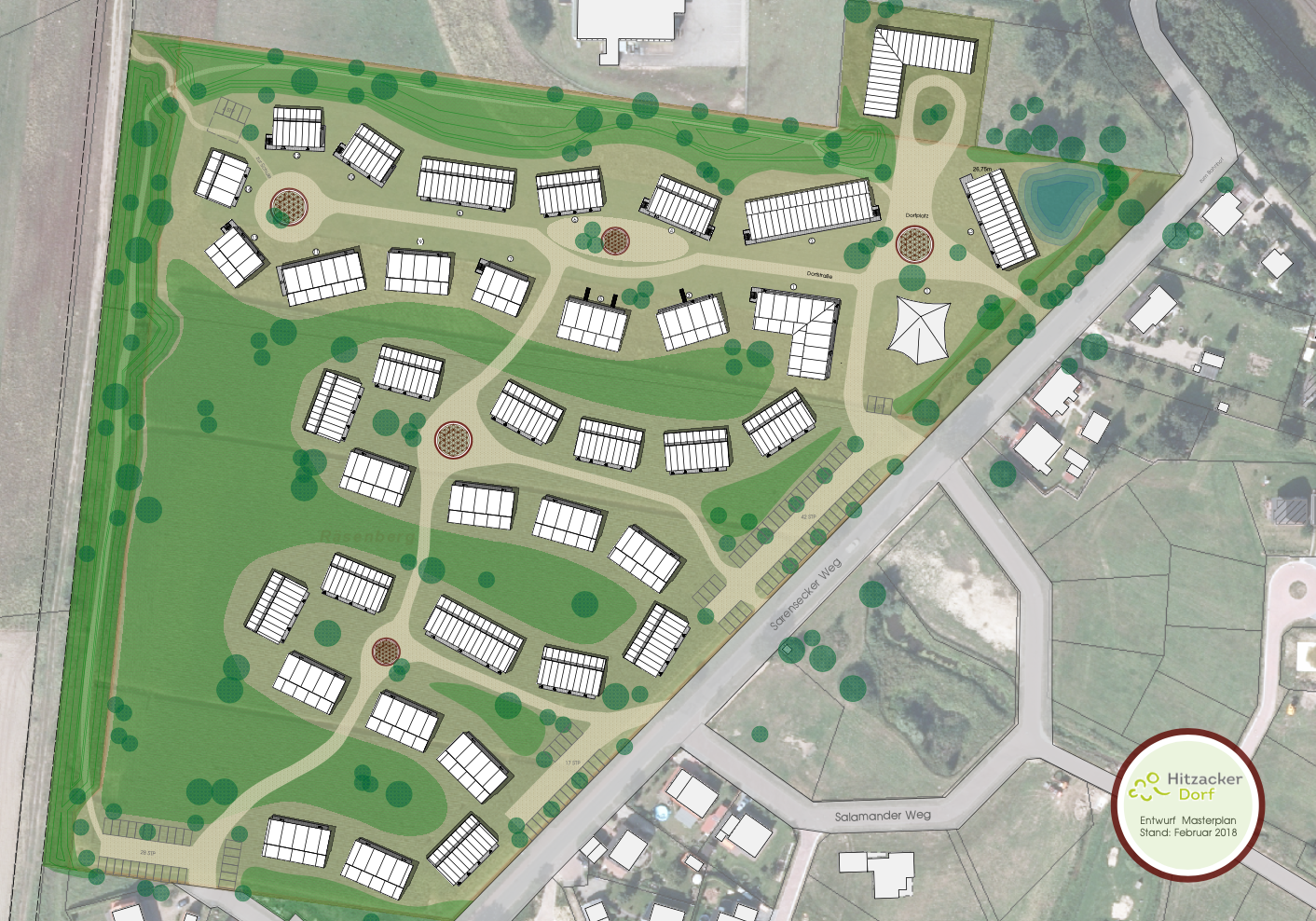
Hitzacker/Dorf
Initiated in 2015, cooperative founded in 2016
Building a village for 300 people: young families, immigrants and refugees & elderly people
Aim: developing a different perspective for living and working in rural area, different welcome culture
Affordable ecological housing and trade
Communal and sustainable living structures
→ website: https://hitzacker-dorf.de
Source: Architektenbüro Frank Gutzeit. https://www.gutzeit-architekt.de

Slide 3

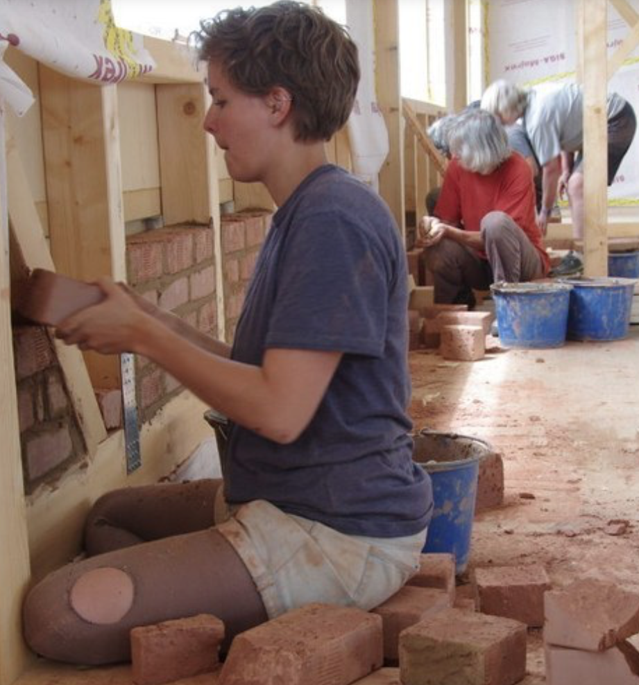
Methodology
ethnographic fieldwork
Participatory observation
People-centred approach
Material: narrative interviews, field diary
Participatory approach: workshop with interviewees to discuss and revise tentative research results

Slide 4
Theoretical Framework

Slide 5
Example: Field of Tension & Transformation Process
Conformity
Contradiction
Hitzacker
/
Dorf
“we are part of the town. It would be a disaster if we were (…) segregated.”
“We want to be a real village”
„We want to imagine village completely new“
Land & Landscape: Home, Familiarity
Land & Soil: Difference, Anti-capitalist tendency
“I like the land here a lot. I feel like just before Hitzacker all the way down to Dannenberg there is this landscape where I felt at home straight away. It was this strange feeling of arriving. Being at home.”
“I am glad we’re building on a place that is not particularly fertile. (…) Gardens are generally overfertilised. And exorbitantly fat. And our entire society is somehow overfertilised and fat. (…) I mean, it’s more my approach to say, let’s scale it down to a size we can handle. That makes sense ecologically.”

Slide 6
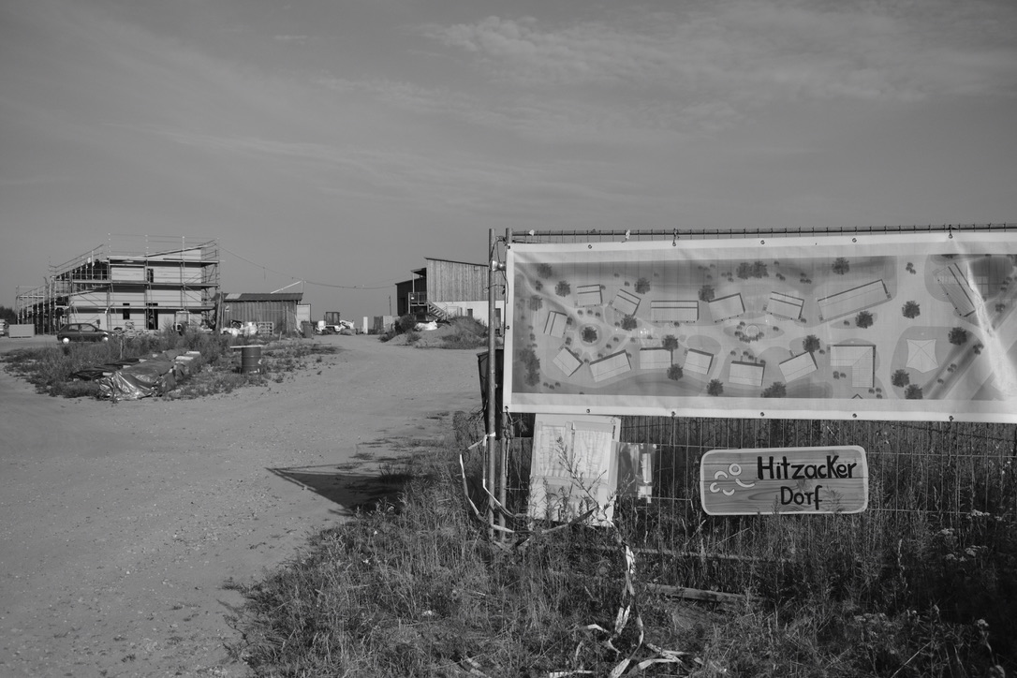
Thank you!
Rebekka Diestelkamp
rebekka.diestelkamp@gmail.com

